Slide 1

KANTIPUR ENGINEERING COLLEGE [Subject Code-EX654] A MINOR PROJECT FINAL DEFENCE ON “GESTURE CONTROL WHEELCHAIR”
Project Members
Karan K. C. [04/BEX/073]
Rudra Narayan Jha [12/BEX/073]
Sanjeev Jung Chaudhary [13/BEX/073]

Slide 2
CONTENTS
Introduction
Objectives
Features
System Requirements
Methodology
Applications
Results

Slide 3
INTRODUCTION
People are having problems of lower body paralysis or difficult to walk caused by accidents or by birth.
Our system helps them to move easily with their simple hand movement.

Slide 4
OBJECTIVES
To create gesture control wheelchair using flex sensor, GY521 and nRF24L01 module.
To create auto speed control system using GY521

Slide 5
FEATURES
Operated easily with hand gesture.
Auto speed control system in up and down hill.
Effective implementation.
Cost effective with more functionality.

Slide 6
System Requirements
Software Requirements
Arduino IDE
Proteus
Notes:
The system requirements for our project are software requirement and hardware requirement.
In software part we have used Arduino ide and proteus.
Arduino ide is the open source software which makes it easy to write code and upload it to the board.
Proteus is a software tool suite used primarily for electronic design automation which helps us to test our circuit design to see if it is working or not.

Slide 7
System Requirements(continued)
Hardware Requirements
Flex sensor
GY521
Arduino UNO
L298N motor driver
DC motors
nRF24L01 module
Notes:
And in hardware part we have used flex sensor, GY521, Arduino Uno, L298N motor driver, DC motors and nRF24L01 module.
Flex sensor is a sensor that measures the amount of deflection or bending by which its resistance value is changed.
we have used GY521 which works both as accelerometer and gyroscope. Accelerometer measures changes in gravitational acceleration in a device by which we can change the direction of wheelchair left, right, forward and backward. And gyroscope measures the angle of a device by which we can maintain the speed of the wheelchair in inclined surface.
Arduino Uno is a microcontroller board which can be programmed with the help of Arduino ide to control the different devices.
L298N motor driver is a motor driver IC which allows dc motor to drive on either direction and it can control two dc motors independently.
nRF24L01 module is a transceiver for the world wide 2.4 - 2.5 GHz ISM band which works for both transmitting and receiving signal.
And we have used dc motors in our projects to drive the wheelchair.

Slide 8
METHODOLOGY
Figure (i): Block Diagram of Controller
GY521
Arduino UNO
nRF24L01 module (transmitter)
Flex sensor
Notes:
In methodology of our project.
This is the block diagram of controller- Arduino Uno reads the data from GY521 and flex sensor and with the help of nRF24L01 module it transmits the data.

Slide 9
Arduino UNO
DC Motor 1
Figure (ii): Block Diagram of Wheelchair
L289N motor driver
nRF24L01 module (receiver)
DC Motor 2
GY521
Notes:
And this is the block diagram of wheelchair- here nRF24L01 module receive the transmitted data from the controller. Arduino Uno processes the data received by nRF24L01 module as well as reads the data from GY521 and decides what to do and drive the dc motors in left, right, forward and backward direction. Here in case of inclined surface, this GY521 reads the angle and if the reading is greater or less than15 degree then we use flex sensor to drive the wheelchair and control speed.

Slide 10
TURN ON CONTROLLER
READ DATA FROM SENSOR
Figure (iii): Flowchart of Controller
IS DATA IS PRESENT?
NO
WAIT FOR GESTURE
YES
RESULTS CORRESPONDING OUTPUT
TRANSMITS DATA

Slide 11
RECEIVE DATA
IF DATA IS RECEIVED?
NO
Figure (iv): Flowchart Of Wheelchair
YES
IS x>=30||
x<=-30||y>=30||y<=-30?
NO
YES
CONTROL MOVEMENT

Slide 12
READ DATA FROM GY521
NO
YES
Figure (v): Flowchart of Speed Controller
IF x>= 15 ||
x<= -15?
CONTROL SPEED OF MOTOR

Slide 13
APPLICATIONS
Helps disabled people to move easily and freely.
Helps to move on uphill and downhill.

Slide 14
RESULTS
Wheelchair movement controlled by gesture
Manually speed controlled in plain area
Automatic speed controlled in inclined area

Slide 15
LIMITATIONS
Cannot lift heavy weight.
Emergency breaking system is not available.
In down hill it automatically fell.
In up hill free wheel drifts.

Slide 16
FUTURE ENHANCEMENT
Emergency breaking system
Heavy load lifting

Slide 17
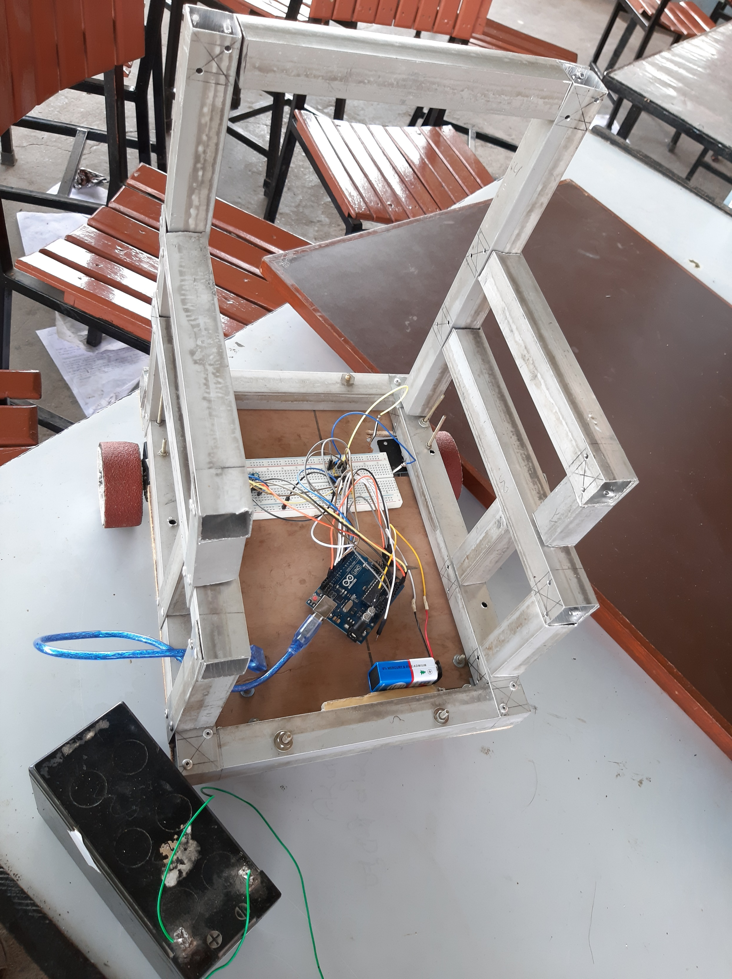
SNAPSHOTS

Slide 18
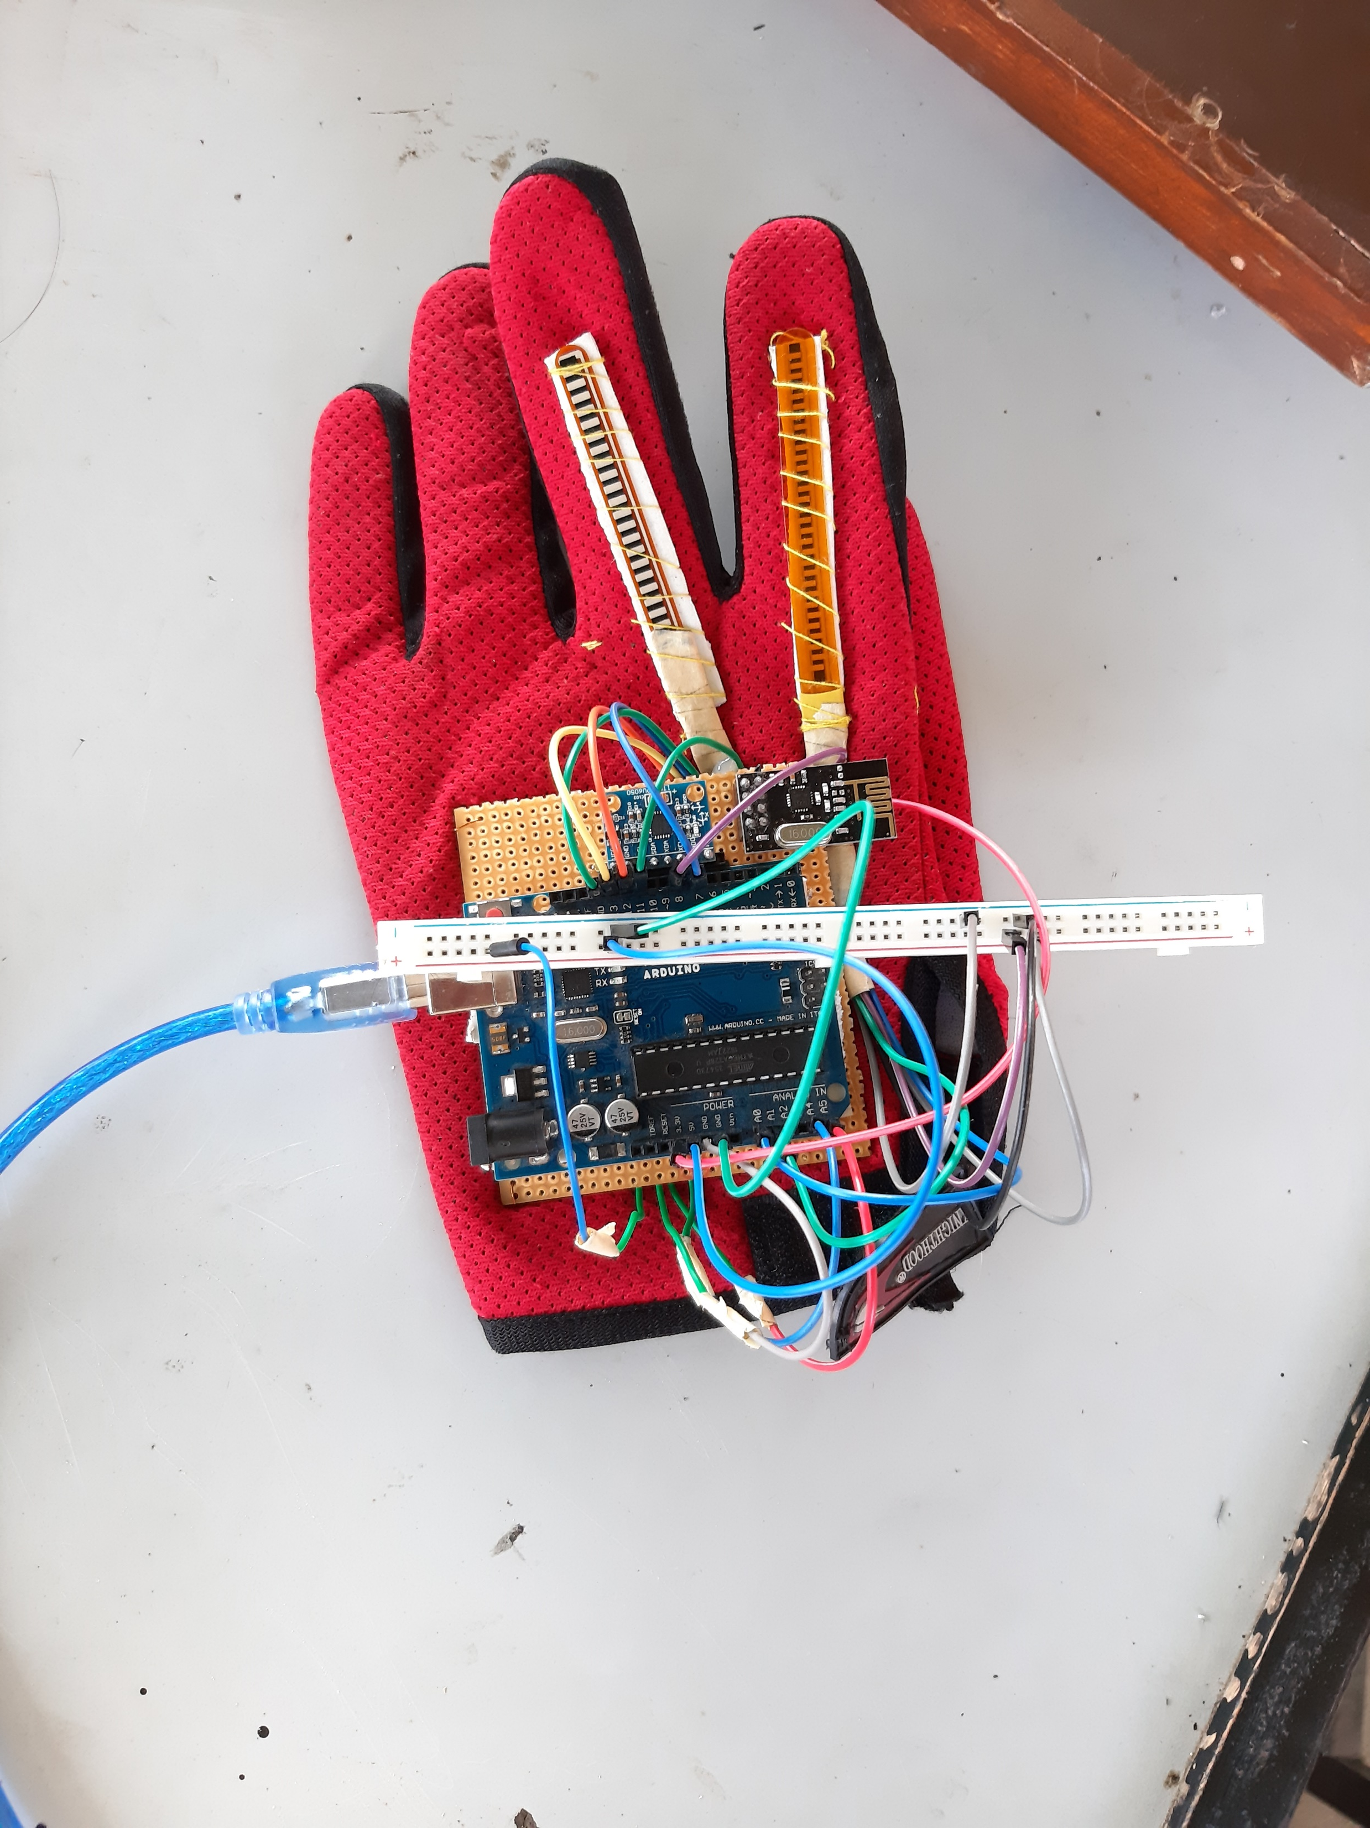

Slide 19
THANK YOU

